Slide 1
E-commerce Price Comparison Bot
A comprehensive overview of a Python-based project to compare online prices.

Slide 2
Introduction
In today’s digital world, prices of products vary across e-commerce platforms. Manually comparing prices can be time-consuming. To address this, we’ve created an E-Commerce Price Comparison Bot using Python and Selenium that automates this task and helps users make informed buying decisions.
.

Slide 3
Project Overview
Project Overview This project is a Python-based automation tool that scrapes product prices from popular Indian e-commerce websites like Flipkart, Amazon, and Croma , and displays a side-by-side price comparison for the user’s desired product.
.

Slide 4
Introduction to the E-commerce Price Comparison Bot
The E-commerce Price Comparison Bot is a Python application designed to analyze prices of products listed on various online retail platforms. By integrating with multiple APIs, it fetches current pricing data and presents users with the best available options in real-time.
The bot takes a product name as input, navigates to each e-commerce website, searches the product, extracts the price of the top-listed item, and finally displays the price from each platform in a readable format.

Slide 5
Objectives and Goals
Automate the price comparision process.
Help consumers identify the best price for a product.
Provide a simple and fast tool to search multiple websites at once.
Demonstrate the use of web scraping and browser automation.
The primary objectives of the bot include providing users with the ability to easily compare prices across different e-commerce sites, enhancing shopping efficiency, and saving time and money on purchases. Additionally, the bot aims to aggregate customer reviews and product ratings to assist in informed buying decisions.

Slide 6
Target Audience
Online shoppers looking to save money.
Student and developers interested in automation.
Price comparison sites or apps seeking automation modules.
E-commerce analysts researching pricing patterns.
The target audience for the E-commerce Price Comparison Bot includes tech-savvy shoppers, budget-conscious consumers, and e-commerce enthusiasts looking for the best deals. Furthermore, businesses aiming to integrate price comparison functionalities into their platforms may find the bot's capabilities valuable for enhancing user experience.

Slide 7
Technical Architecture
The target User Input Layer: Command-line input to enter product name.
Automation Layer: Selenium WebDriver simulates user activity.
Scraping Layer: Extracts price and product name from the site.
Output Layer: Displays formatted results in the console.

Slide 8
Framework and Technologies Used:
Data Sources and APIs
Python – Programming language.
Selenium – Automation tool to control the browser.
Chrome Driver & Web Driver Manager – Browser drivers.
CSS Selectors / XPaths – For navigating web elements.
Web Driver Wait – For dynamic content loading.
Flipkart.com – Product listings and prices.
Amazon.in – Official Amazon India storefront.
Croma.com – Electronics retailer platform.
Note: No APIs are used; all data is extracted through web scraping via Selenium.

Slide 9
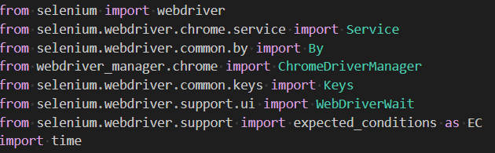
Required Libraries:
9

Slide 10
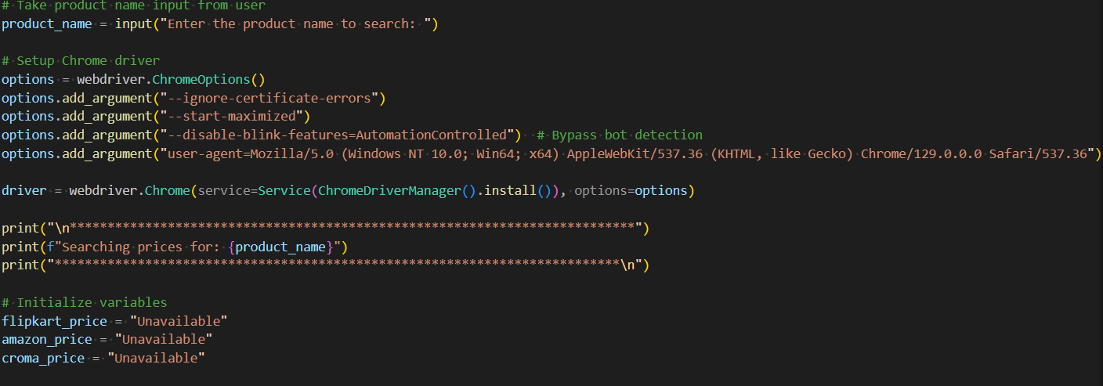
Taking Input & Setting Up Chrome
10

Slide 11
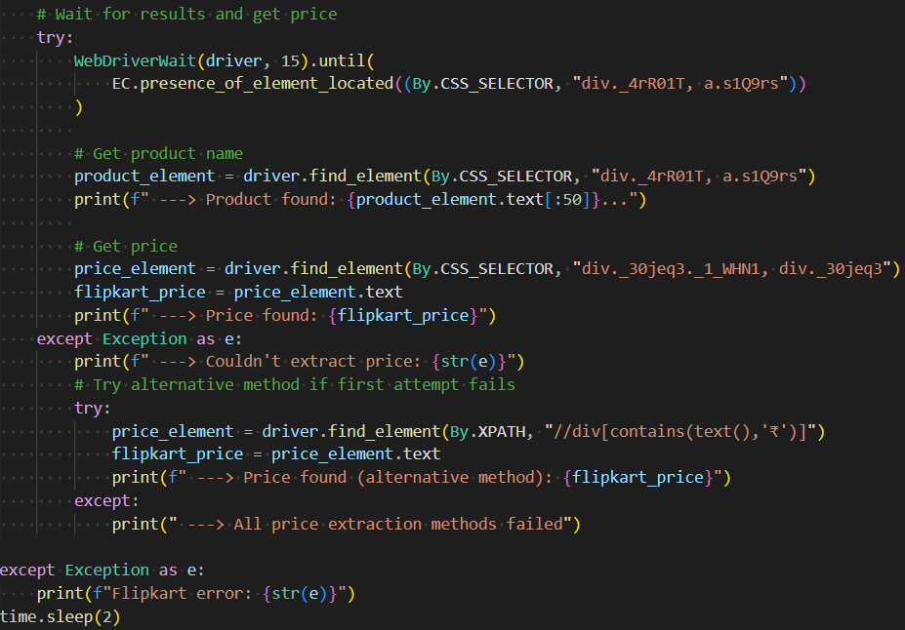
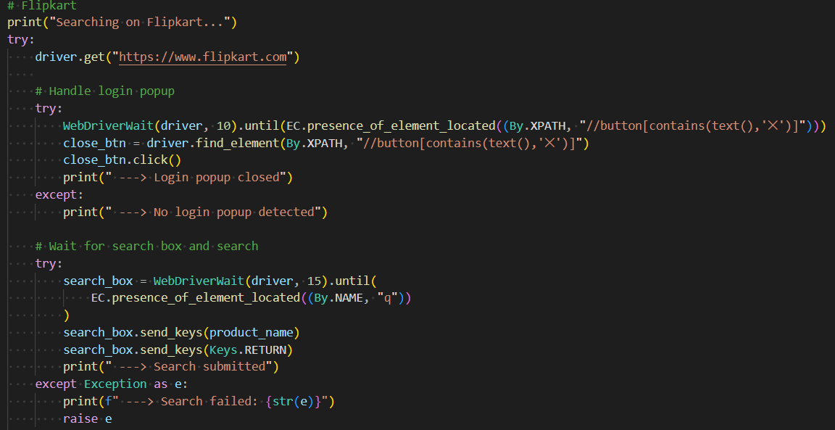
Searching on FlipKart:
11

Slide 12
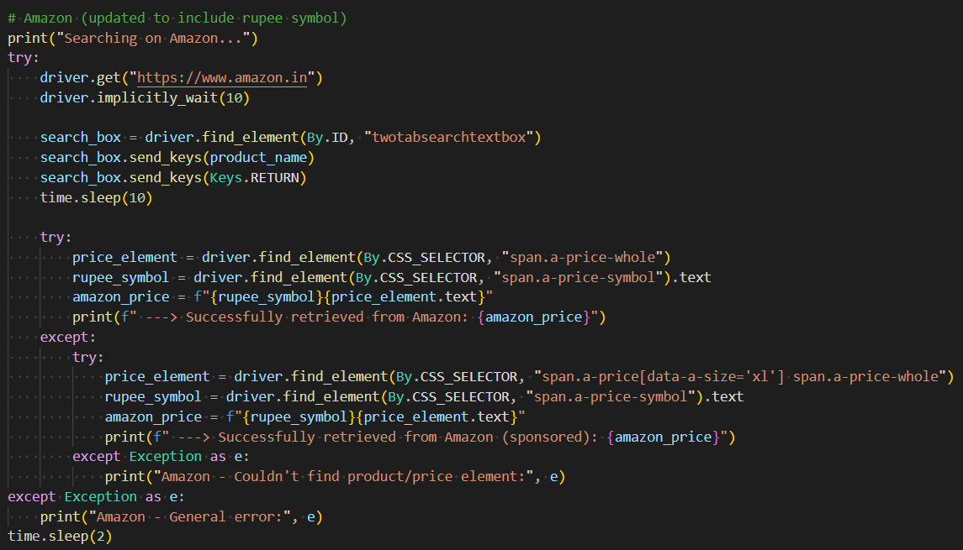
Searching on Amazon:
12
Notes:
12

Slide 13
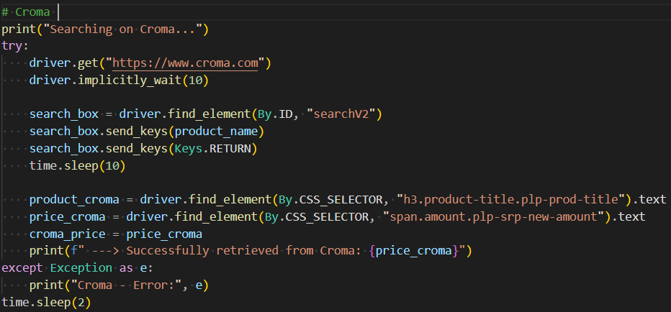
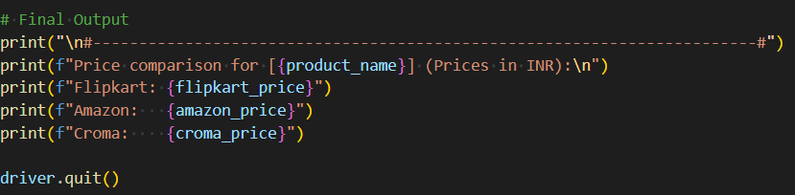
Searching on Croma:
Final Output:
13

Slide 14
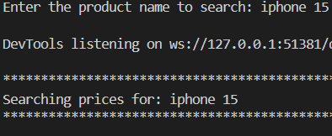
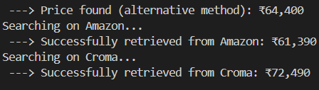
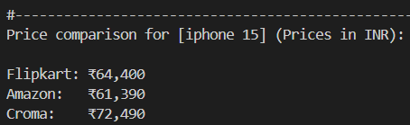
Sample Output:
14

Slide 15
Conclusions
This project demonstrates how automation can simplify everyday tasks like online shopping.
The E-commerce Price Comparison Bot serves as a powerful tool for consumers, streamlining the search for the best prices while enhancing the shopping experience. Its robust technical architecture ensures reliable performance and easy integration, making it an ideal solution for both individual users and businesses.
It also showcases the power of Python and Selenium in real-world applications. The bot can be further enhanced by:
Adding more platforms (like Reliance Digital, TataCliq).
Building a web interface.
Storing historical price data for analytics.

Slide 16
Thank you!

